Slide 1
Ising superconductivity in gated MoS2
陈光毅
导师：陈剑豪
量子材料中心
17.12.15

Slide 2
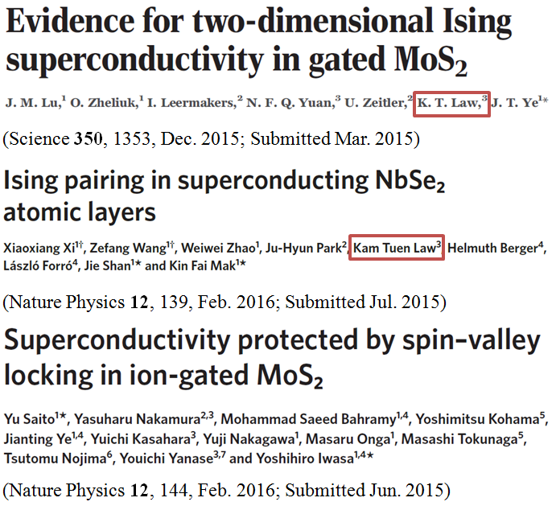

Slide 3


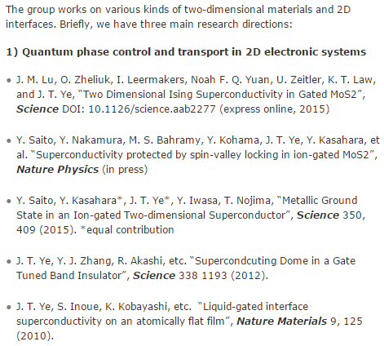
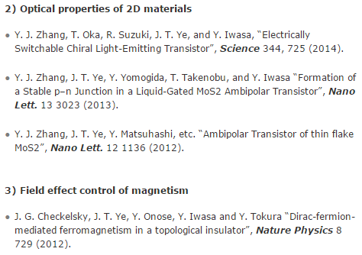

Slide 4
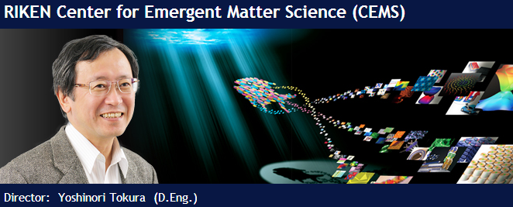
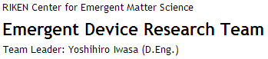
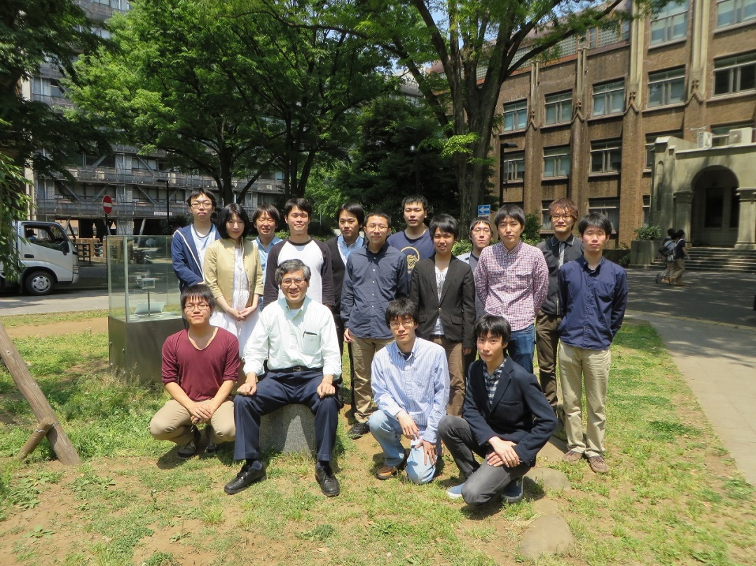
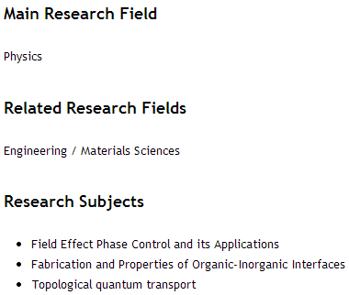

Slide 5
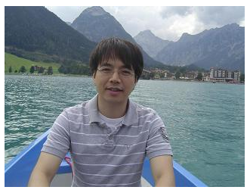

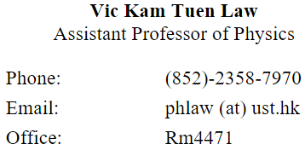
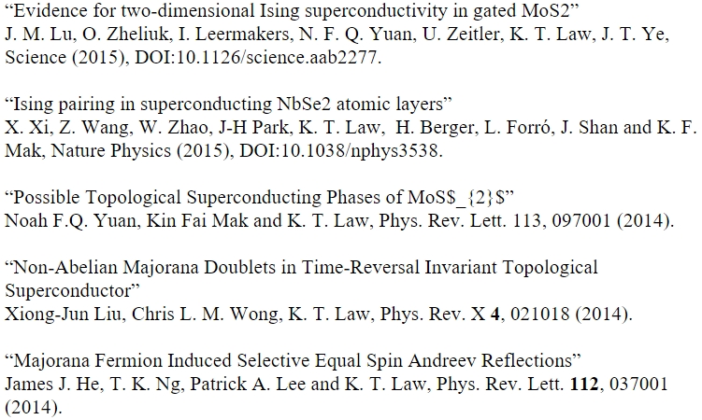

Slide 6
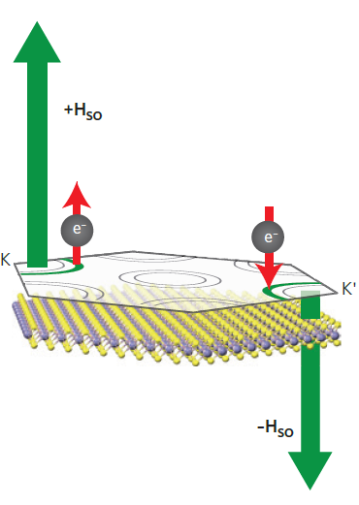
Background
Ising superconductor (Zeeman-protected superconductor):
Intrinsic spin-orbit coupling induced effective Zeeman field with opposite directions in opposite corners (K, -K) locks the spins of Cooper pairs in an Ising-like fashion.
Effective Zeeman field prevents the alignment of the spin to in-plane magnetic fields and hence protects the superconducting state.
In-plane critical field H_{c2} far beyond the Pauli paramagnetic limit.
Notes:
strongly protective when an effective Zeeman field from intrinsic spin-orbit coupling locks the spins of Cooper pairs in a direction orthogonal to an external magnetic field.

Slide 7
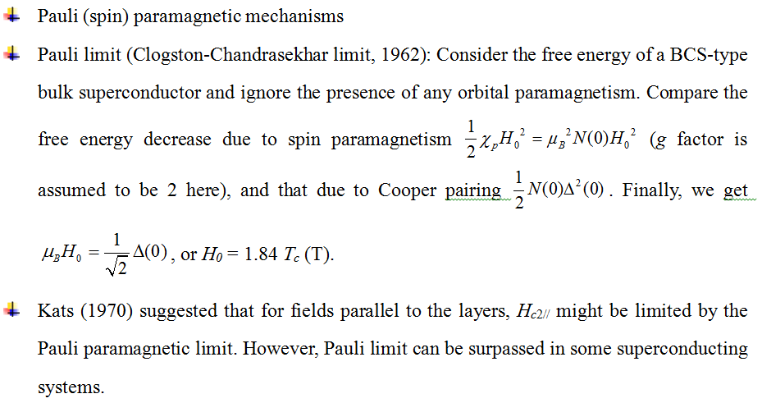
Pauli limit:

Slide 8
In some superconductors, the Pauli limit can be surpassed.
Fulde-Ferrell-Larkin-Ovchinnikov state
Spintriplet superconductor
B_{c2}
B_{p}
Spin-orbit scattering (SOS)
Spin-orbit coupling (SOC)

Slide 9
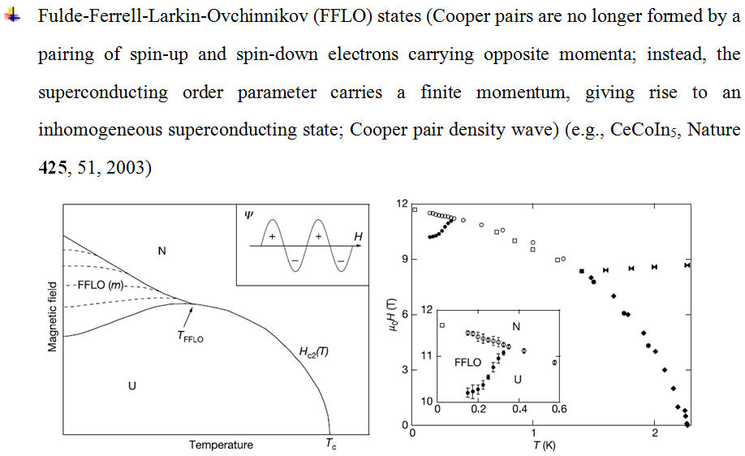

Slide 10
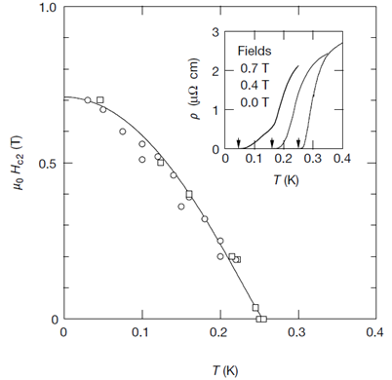
the parallel-aligned spin configuration in Cooper pairs is not affected by Pauli paramagentism, and Bc2 can easily exceed Bp

Slide 11
Pauli limit may be greatly exceeded through spin-orbit scattering, which randomizes electron spins and thus weakens the spin paramagnetic effect.
Several models have been developed to include the effects of Pauli spin paramagnetism and spin-orbit scattering, such as WHH theory and KLB theory.

Slide 12
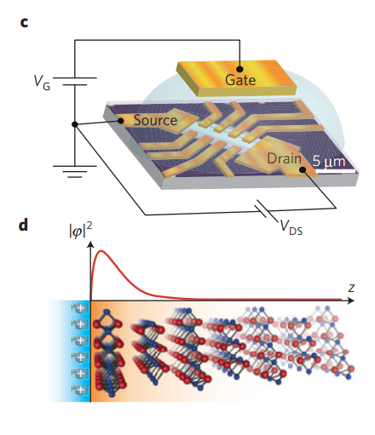
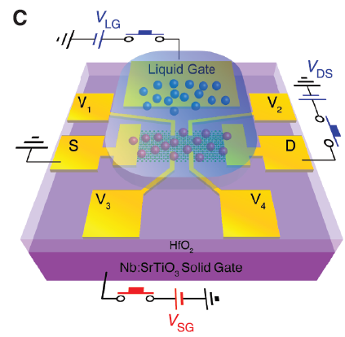
Device
EDLT: electric double-layer transistors
Ultra-high charge-carrier accumulation at the sample/electrolyte interface
Carriers are induced electrostatically without introducing extrinsic disorder
Science 338, 1193, 2012; Science 350, 1353, 2015
Nature Physics 12, 144, 2016

Slide 13
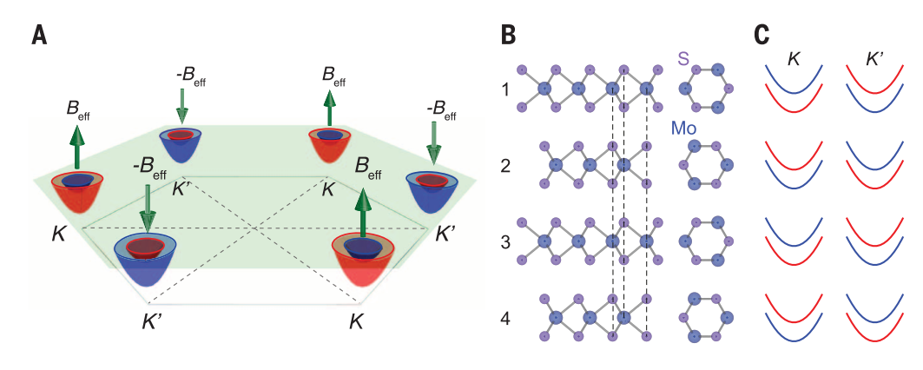
MoS₂
Science 338, 1193, 2012; Science 350, 1353, 2015
In-plane ISB in monolayer
SOC
B_{eff}
Notes:
Conduction-band electron pockets near the K and K' points in the hexagonal Brillouin zone of monolayer MoS2. Electrons in opposite K and K' points experience opposite effective magnetic fields Beff and –Beff, respectively (green arrows). The blue and red colored pockets indicate electron spins oriented up and down, respectively. (B) Side view (left) and top view (right) of the four outermost layers in a multilayered MoS2 flake. The vertical dashed lines show the relative positions of Mo and S atoms in 2H-type stacking. In-plane inversion symmetry is broken in each individual layer, but global inversion symmetry is restored in bulk after stacking. (C) Energy-band splitting caused by Beff. Blue and red bands denote spins aligned up and down, respectively. Because of 2H-type stacking, adjacent layers have opposite Beff at the same K points.

Slide 14
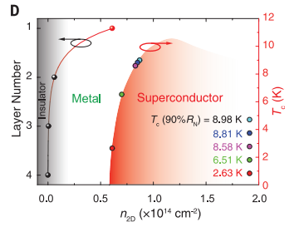
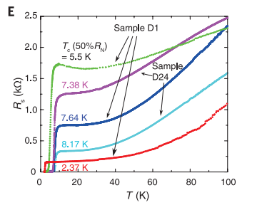
Measurement and Results
n_{2D} of up to 10¹⁴ cm⁻²
Science 338, 1193, 2012; Science 350, 1353, 2015

Slide 15
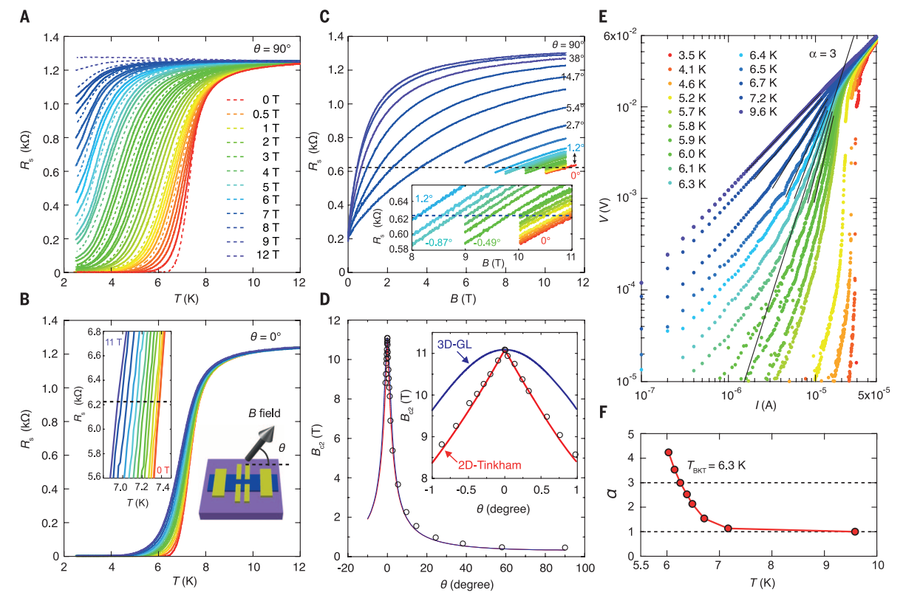
Science 338, 1193, 2012; Science 350, 1353, 2015

Slide 16
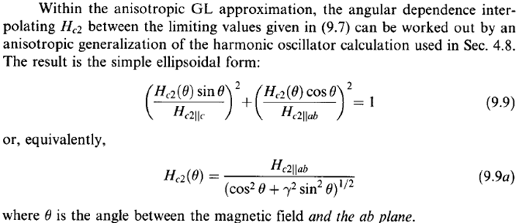
upper critical field of layered superconductors (or superconducting films)
Orbital contributions: coupling between the magnetic field and the electron momentum (current loops, vortex)
Anisotropic Ginzburg-Landau model (Lawrence and Doniach, 1970-71; adapted from M. Tinkham, Introduction to superconductivity)

Slide 17
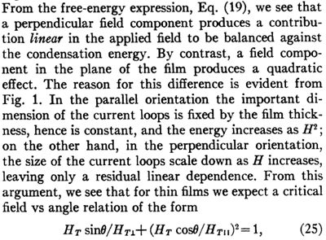
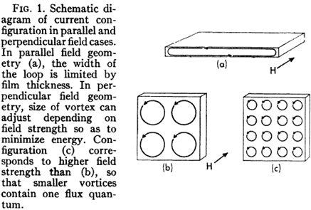
2D Tinkham model (Phys. Rev. 129, 2413, 1963)
Appliable condition for 2D Tinkham model: film thickness d <  (This condition can be easily satisfied since  ~ 500 Å)

Slide 18
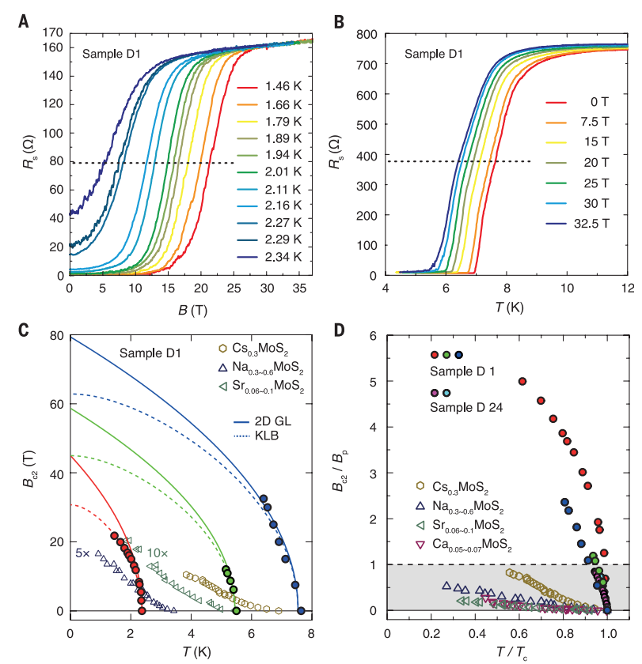
Science 338, 1193, 2012; Science 350, 1353, 2015
Notes:
Magnetoresistance of sample D1 [with Tc(0) = 2.37 K near the onset of the superconducting phase] as a function of an in-plane magnetic field up to 37 T, at various temperatures. (B) Temperature dependence of Rs for sample D1 [with Tc(0) = 7.64 K] under different in-plane magnetic fields up to 32.5 T. The dashed lines in (A) and (B) indicate RN/2. Bc2 is determined as the intercept between dashed lines and Rs curves

Slide 19
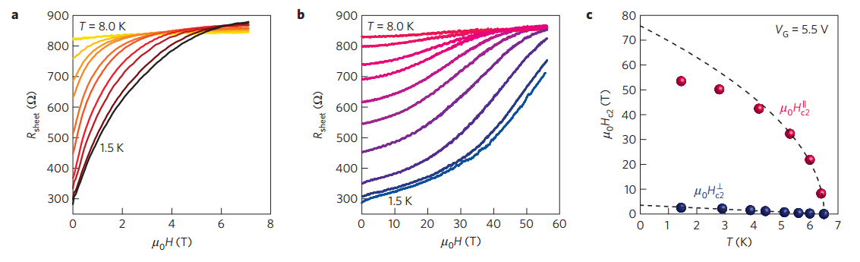
Nature Physics 12, 144, 2016

Slide 20
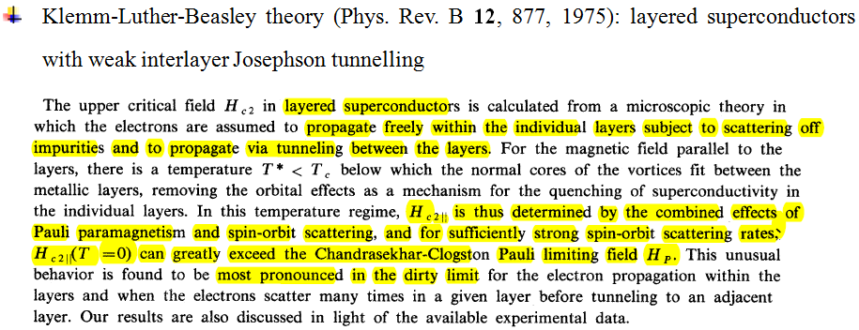
Discussion
When considering superconductivity in the 2D limit, interlayer coupling is set to zero. For strong spin-orbit scattering, the KLB fitting reduces to

Slide 21
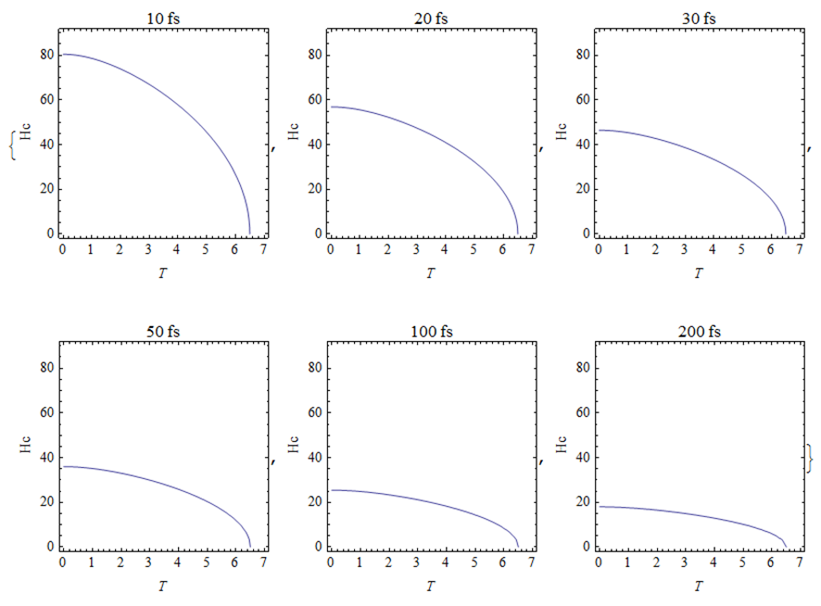
KLB theory yield avery short SOS time of ~24 fs ，which is less than the total scattering time of 185 fs estimated from resistivity measurements at 15 K

Slide 22
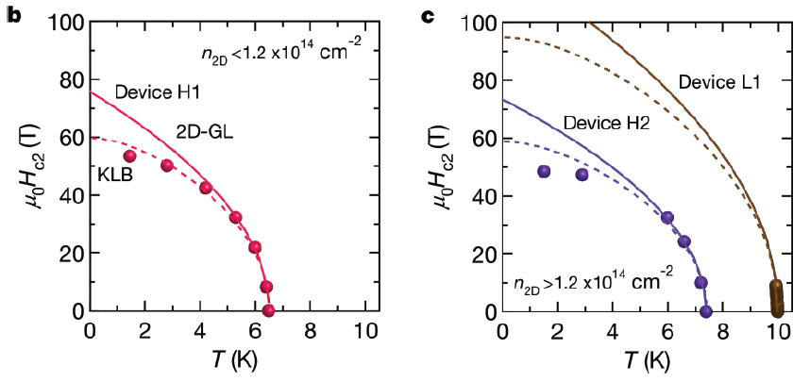
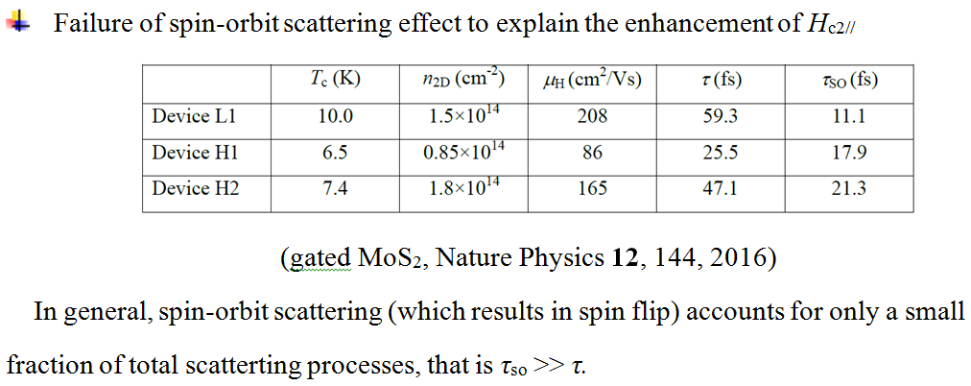

Slide 23
Intrinsic mechanism: Ising superconductivity
B_{c2} enhancement is mainly caused by the intrinsic spin-orbit coupling in MoS2.
Zeeman type SOC
Rashaba type SOC

Slide 24
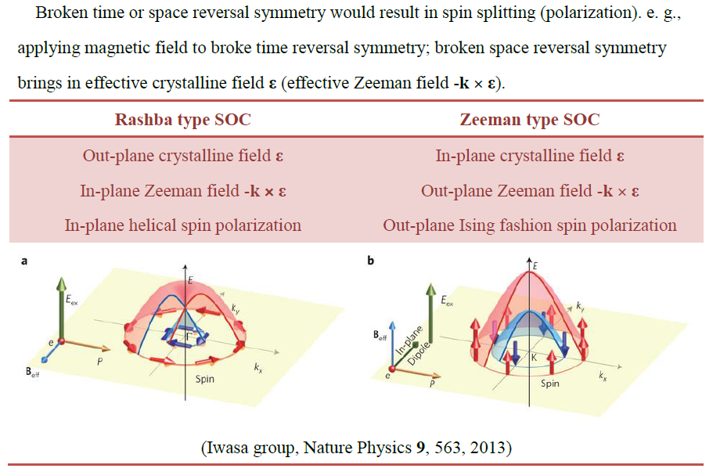

Slide 25
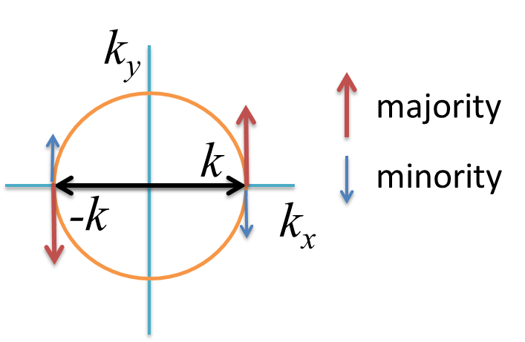
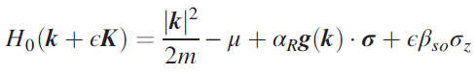
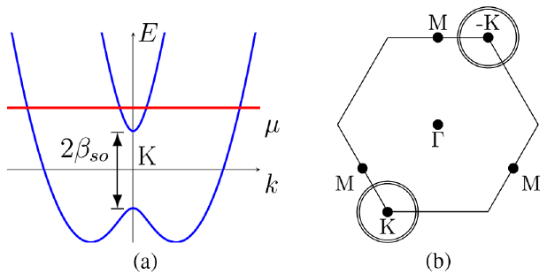
Rashba type SOC
Spin splitting between majority and minority
Zeeman type SOC
Spin splitting between majority and minority
Phys. Rev. Lett 113, 097001 (2014)

Slide 26
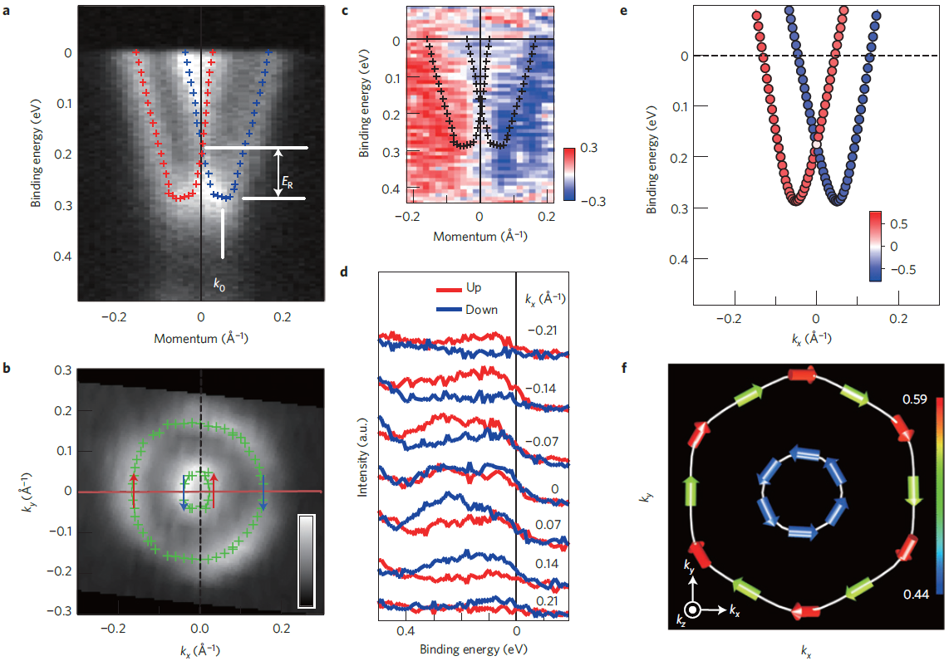
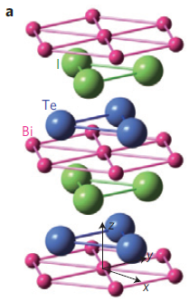
Typical example of Rashba type SOC:
Spin polarization of BiTeI by spin resolved ARPES
Nature Material 10, 521, 2011

Slide 27
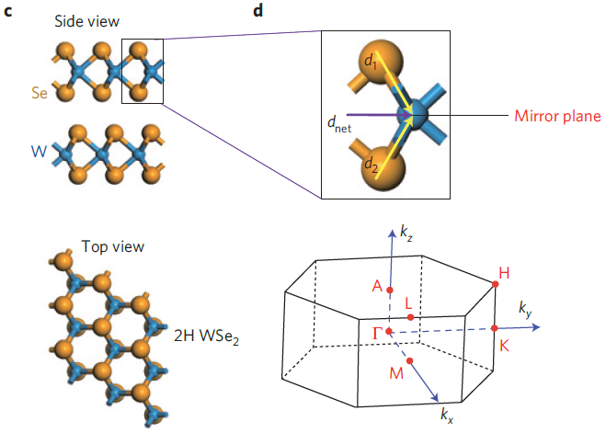
Typical example of Zeeman type SOC: TMDs
D_{3h}: M + C_{3v}
M symmetry suppresses the Rashba term, because it avoids any electric polarity along the z axis required for Rashba spin splitting. (M is broken by gating)
The Zeeman term:
Invariant under
Spin polarization will be aligned along the z axis and becomes maximal/minimal along the -K directions.
Crystalline field
Nature Physics 9, 563, 2013

Slide 28
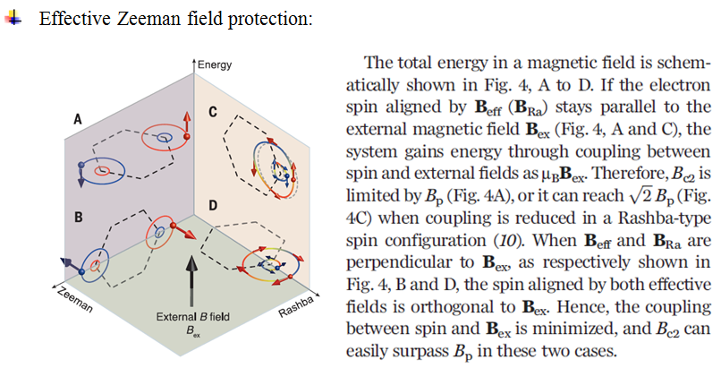
Science 350, 1353, 2015

Slide 29
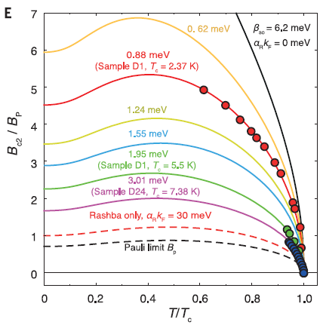
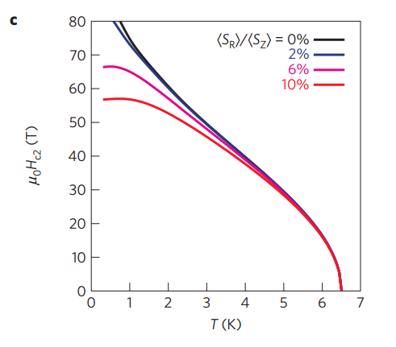
Competition between Rashba and Zeeman type SOC
Rashba SOC alone could only enhance H_{c2//} slightly to 2 H_{p}.
Out plane Zeeman protection would be weakened with stronger Rashba SOC (strong gating, higher T_{c}).
Science 350, 1353, 2015;Nature Physics 12, 144, 2016

Slide 30
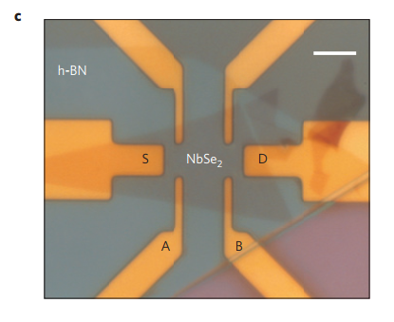
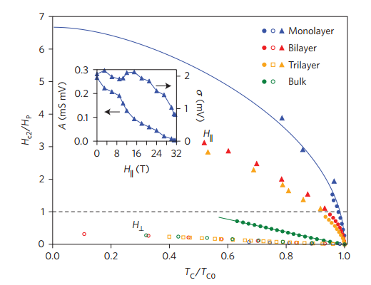
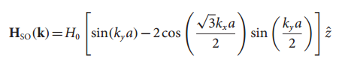
Related works
Nature Physics 12, 139, 2016

Slide 31
Conclusion
Ising Superconductor
MoS2
Other materials and possible mechanism
Notes:
The concept of the Ising superconductor is also applicable to other layered systems, where similar intrinsic SOC could be induced
by symmetry breaking.

Slide 32
Thank you

